Slide 1
EL-V Semester
Exam Preparation Assistant
Presented by -
Shubham Kumar(1RV21AI050)
Aman Tripathi(1RV21AI008)
Pardhiv Varma(1RV21AI036)
Vaishnavi(1RV21AI060)
DATE - 29th December, 2023

Slide 2
OBJECTIVE
Problem Statement:
College students often struggle to identify important or repeated questions from a large pool of past papers, making it hard to focus on crucial topics during exam prep. Manual identification is time-consuming and error-prone. The Exam Prep Assistant project aims to create a smart system using machine learning (ML) and natural language processing (NLP). It helps analyze and suggest important questions, streamlining the process for students. The goal is to automate the identification of key questions, making it easier for students to focus on their studies. The system combines OCR, NLP, and ML to simplify extracting, analyzing, and recommending relevant questions across different subjects and papers.

Slide 3
Criteria for Questions
Frequency
Relevance to Key Topic
Difficulty
Use Case: Determining the difficulty level of questions.
Use Case: Identifying how frequently specific questions or topics appear in historical exam papers.
Use Case: Ensuring that questions are aligned with the key topics of the subject.

Slide 4
Methodology/ Approach details
1. Data Acquisition and Preparation:
Collect past years' question papers: Gather relevant question papers from various sources, ensuring coverage of diverse topics and formats.
Data pre-processing: Clean and standardize the collected data, including text extraction from PDFs, tokenization, handling formatting inconsistencies, and removing irrelevant information.
Labelling: Manually label a subset of questions based on two key categories: frequency (indicating the repetition of questions across papers) and marks (reflecting the importance of questions based on higher marks). This dual classification will provide a more comprehensive basis for training the machine learning models.
2. Machine Learning Model Development:
Model selection: Choose appropriate machine learning algorithms suitable for text classification tasks, such as Support Vector Machines (SVMs), Decision Trees, or Random Forests.
Training: Train the models on the labelled data, optimizing hyperparameters for accurate question categorization within the defined frequency and marks-based categories.
Evaluation: Test and evaluate the trained models on a separate dataset to assess their performance in categorizing questions based on both frequency and marks. This approach ensures a robust evaluation of the models' effectiveness across the dual classification criteria and identifies potential areas for improvement.

Slide 5
Methodology
3. Application Development and Integration:
Front-end development: Design and develop a user-friendly interface for uploading papers, interacting with the study plan, and providing feedback.
Back-end development: Implement the core functionalities of the assistant, incorporating the dual classification system based on both question frequency and marks. Develop algorithms that seamlessly integrate the categorized questions into a personalized study plan for users.
Integration: Ensure the smooth integration of the trained models, accommodating the dual categorization criteria, with the application backend. This integration will enable the assistant to effectively analyze questions based on both frequency and marks, providing users with a comprehensive and tailored study experience.
4. Testing and Deployment:
Beta testing: Conduct beta testing with a small group of target users to gather feedback on the app's functionality, usability, and the effectiveness of the dual classification system. Encourage users to provide insights into how well the assistant identifies important questions based on both frequency and marks.
Iterative improvement: Based on beta testing results, iteratively improve the application by addressing user feedback, refining the dual classification system, fixing bugs, and enhancing features. This iterative process ensures that the Exam Prep Assistant evolves to meet the specific needs and expectations of its users.
Deployment: Launch the refined Exam Prep Assistant on app stores or platforms relevant to the target audience, emphasizing its ability to categorize questions based on both frequency and marks. Ensure accessibility and security during the deployment phase to provide a reliable and user-friendly exam preparation tool for students.

Slide 6
WORKFLOW PHASE 1/SYSTEM ARCHITECTURE
OCR
Creating of Dataset
Extraction of Collocations
Tokensation
LDA
Frequency Table
Stemming
Removing Stopwords

Slide 7
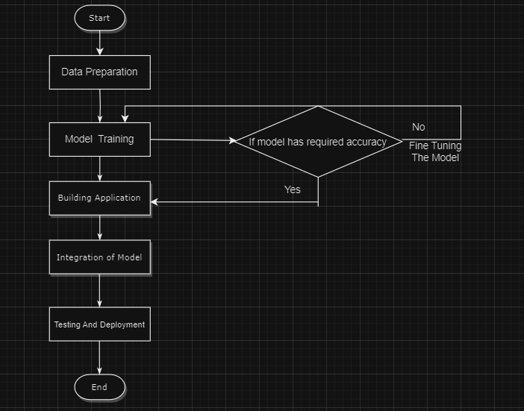
System architecture
Complete Workflow:

Slide 8
Literature Survey
Sl no | Author and Title | Publication Details | Summary
1. | OPTICAL CHARACTER RECOGNITION Dr. V. Geetha, Ch V V Sudheer, A V Saikumar, Dr C K Gomathy | May 2022 | The project is about OCR. It stands for "Optical Character Recognition." OCR is an input device used to read a printed text. OCR scans the text optically, character by character, converts them into a machine readable code and stores the text on the system memory and convert it into Document. The technology of optical character recognition (OCR) was used to transform printed text into editable text. In a variety of applications, OCR is a very helpful and popular approach. Text preparation and segmentation techniques can influence OCR accuracy. Because of the image's varying size, style, orientation, and intricate backdrop, retrieving text from it might be challenging at times. It is a technology that recognizes text within a digital image. It is commonly used to recognize text in scanned documents and images. OCR can be used to convert a physical paper document, or an image into an accessible electronic version with text.
2. | A Study of Text Classification Natural Language Processing Algorithms for Indian Languages Jasleen Kaur and Dr.Jatinderkumar R. SAINI | VNSGU Journal of Science and Technology – V 4(1) - 2015-163 | In this informative age, many documents in different Indian Languages are available in digital forms. For easy retrieval of these digitized documents, these documents must be classified into a class according to its content. Text Classification is an area of Text Mining which helps to overcome this challenge. Text Classification is act of assigning classes to documents. This paper provides the analysis of Text Classification works done on Indian Language content. Text being present in Indian language imposes the challenges of Natural Language processing. This study shows that supervised learning algorithms (Naive Bayes (NB), Support Vector Machine (SVM), Artificial Neural Network (ANN), and N-gram) performed better for Text Classification task.
3. | Question-And-Answer System Using Natural Language Processing Tatenda Allan Beta | Harare Institute of Technology September 2023 | Most organization are subject to large volumes of data which is stored in indifferent formats some on websites, some as pdfs files as a result the retrieval and the exploration of this large amount of information becomes so difficult, complex, frustrating and expensive in terms of time associated in retrieving that particular information as a result organizations and schools need to move towards automated data retrieval solutions that use AI technologies such as NLP which allows hence in this paper an information extraction system (question and answer) is proposed so as to support Institutes and business to easily obtain information that is required in less amount of time as well as to ensure customer satisfaction due to the availability of a system which is able to provide information required by customers or personnel easily. By utilizing these automated data extraction tools, organizations and schools can increase their productivity by putting an end boring and autonomous manual searching processes which involves scanning through thousands of pages scraps at time!

Slide 9
Literature Survey
Sl no | Author and Title | Publication Details | Summary
1. | Latent Dirichlet Allocation David M. Blei, Andrew Y. Ng, Michael I. Jordan | May 2022 | We describe latent Dirichlet allocation (LDA), a generative probabilistic model for collections of discrete data such as text corpora. LDA is a three-level hierarchical Bayesian model, in which each item of a collection is modeled as a finite mixture over an underlying set of topics. Each topic is, in turn, modeled as an infinite mixture over an underlying set of topic probabilities. In the context of text modeling, the topic probabilities provide an explicit representation of a document. We present efficient approximate inference techniques based on variational methods and an EM algorithm for empirical Bayes parameter estimation. We report results in document modeling, text classification, and collaborative filtering, comparing to a mixture of unigrams model and the probabilistic LSI model.
2. | SUPPORT VECTOR MACHINES: THEORY AND APPLICATIONS Theodoros Evgeniou INSEAD Massimiliano Pontil University College London | Theodoros Evgeniou and Massimiliano Pontil Center for Biological and Computational Learning, and Artificial Intelligence Laboratory, MIT, E25-201, Cambridge, MA 02139, USA | This paper presents a summary of the issues discussed during the one day workshop on "Support Vector Machines (SVM) Theory and Applications" organized as part of the Advanced Course on Artificial Intelligence (ACAI 99) in Chania, Greece. The goal of the paper is twofold: to present an overview of the background theory and current understanding of SVM, and to discuss the papers presented as well as the issues that arose during the workshop.

Slide 10
Client/Stakeholders
College Students (End Users):
Role: Primary users of the Exam Prep Assistant.
Interest: Access to a user-friendly platform that facilitates efficient exam preparation by identifying important and repeated questions.
2. Educators/Professor:
Role: Involved in guiding students and may provide feedback on the relevance and effectiveness of the Exam Prep Assistant.
Interest: An effective tool that enhances students' exam preparation without compromising educational standards.
3. Content Providers ( Secondary )

Slide 11
Input source and Imaginary output
1. Previous Years' Question Papers:
The project requires access to a diverse set of previous years' question papers from various subjects and courses.
These question papers serve as the foundational data for the system to analyze and identify important and repeated questions.
2. Text Books Mentioned that strictly contain content related to Syllabus
This is to find exactly which lines of a particular webpage is necessary for the student to read
3. Available material on the VTU website Semester Wise

Slide 12
Tech Stack
OCR (Optical Character Recognition) Technology:
OCR is used to convert scanned or image-based question papers into machine-readable text.
This technology enables the system to extract textual information from physical or image formats, making it accessible for further analysis.
Natural Language Processing (NLP) Models:
NLP models play a crucial role in understanding the semantics and context of the questions.
Textual data extracted from question papers undergoes NLP processing to identify patterns, topics, and recurring themes.
Transformers from Hugging Face (Pretrained models)
Machine Learning Algorithms:
Machine learning algorithms analyze the processed data to identify trends, patterns, and correlations among questions.
These algorithms help in determining the importance and recurrence of specific questions across different papers.
Document Parsing
Define Objectives and Criteria PyPDF2 or pdfminer for extracting text from PDF files.
Database
Web Development And Front End Frameworks

Slide 13
Societal impact
The Exam Prep Assistant project has the potential to bring about several positive changes and contributions to society:
Time Efficiency and Productivity
Equal Access to Resources
Reduced Stress and Anxiety
Improved Academic Performance
Enhanced Learning Experience
Technological Advancements in Education
Global Accessibility
Preparation for Future Challenges

Slide 14
THANK YOU

